Slide 1


Anomaly Detection in Wind Turbine
using Data Science and Big Data
Anish Mahapatra | 19 October, 2021

Slide 2

Agenda
01
Introduction
02
The Data Lifecycle
03
Production Machine Learning Architecture
04
Predictive Maintenance Dashboard
05
The Data Science Process Flow
06
Q&A Session

Slide 3










Topic 1 of 6
Introduction
Senior Data Scientist
LinkedIn: www.linkedin.com/in/anishmahapatra Medium: anishmahapatra.medium.com Website: www.anishmahapatra.com
GitHub: www.github.com/anishmahapatra
Q. How to get into Data Science?
A. Simple, ask a real-world Data Scientist.

Slide 4
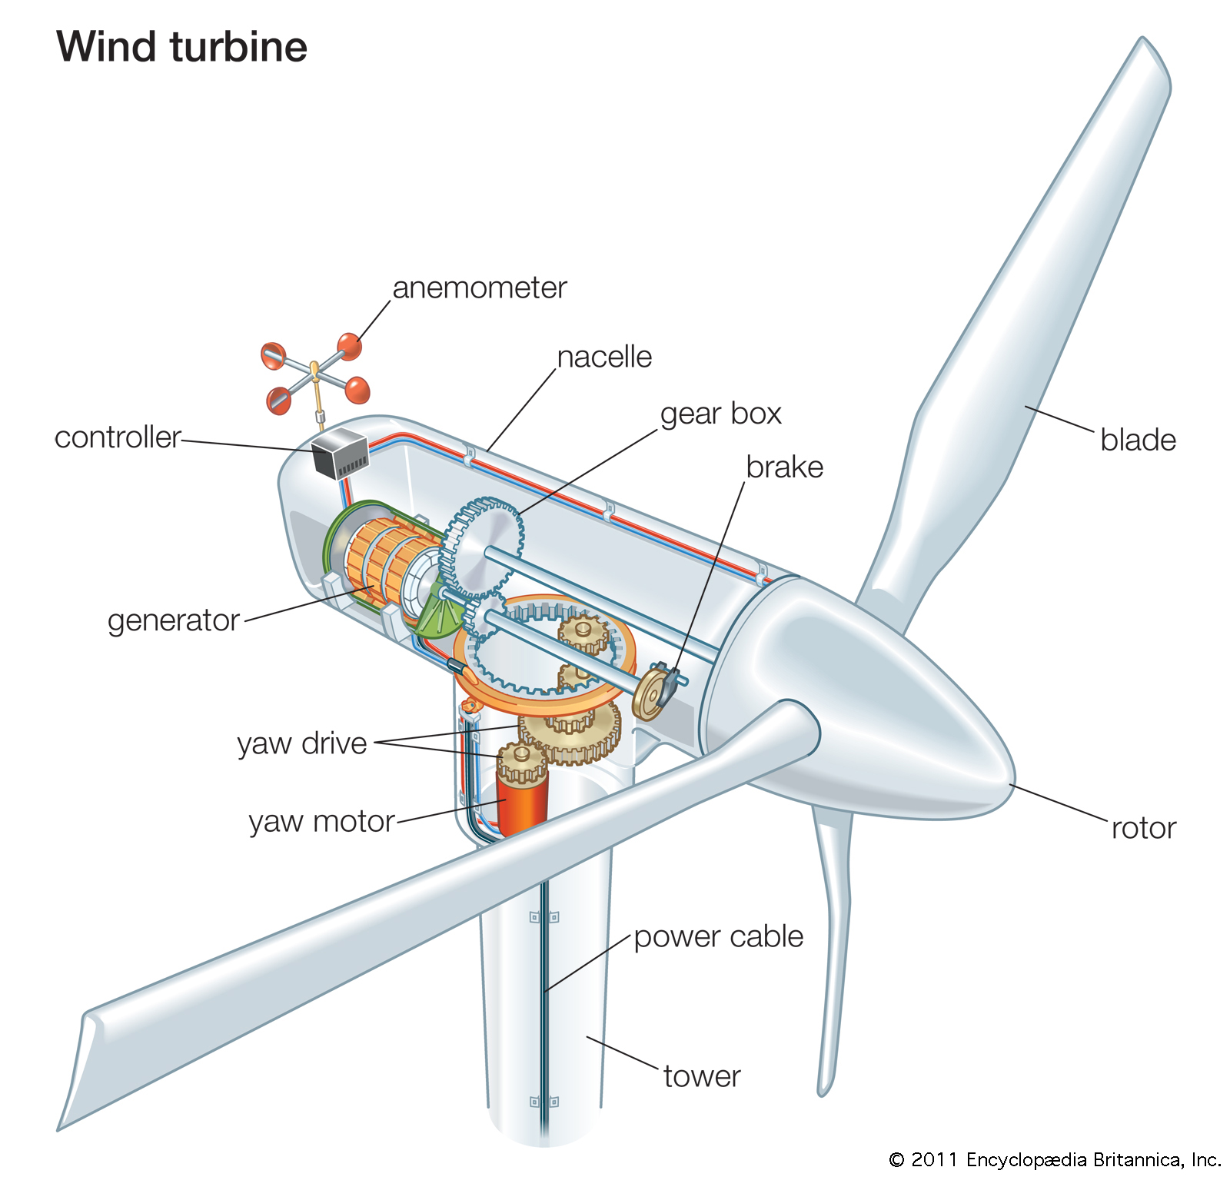




Topic 1 of 6
The Energy Industry
$882 Billion
Energy Industry Valuation 2021
Industrial
IoT
External
Data
Turbine
Data
25%
Cost savings using Predictive Maintenance

Slide 5
Topic 2 of 6
The Data Lifecycle
01
02
03
Understand the Data
Data Exploration
Data Roll-up
Source the data, Create Data Dictionary, View Data Summary, View Data Distribution
Exploratory Data Analysis, Make ER Diagram, Main Analytical Data frame
Aggregation and roll-up of data, Merging of Data on relevant keys, Unit testing, Building pipelines to experiment,
06
05
04
Model Evaluation
Model Interpretability
Feature Engineering
Model Evaluation, Monitoring Model Performance and Drift, Data Governance Policies
Model Interpretability using SHAP, Machine Learning interpretation, Business Explainability
Building new features, Combining external data, Building a feature store

Slide 6
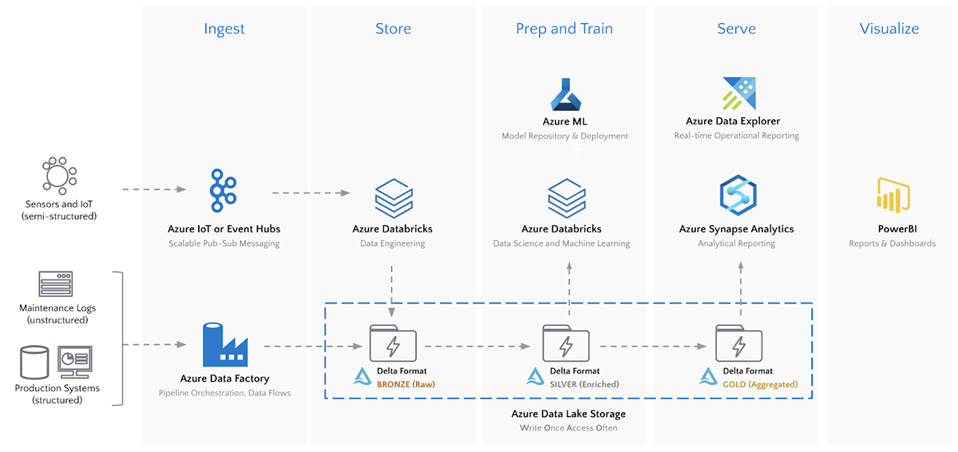
Topic 3 of 6
Production Machine Learning Architecture
Notes:
Source: https://databricks.com/blog/2020/08/03/modern-industrial-iot-analytics-on-azure-part-1.html

Slide 7
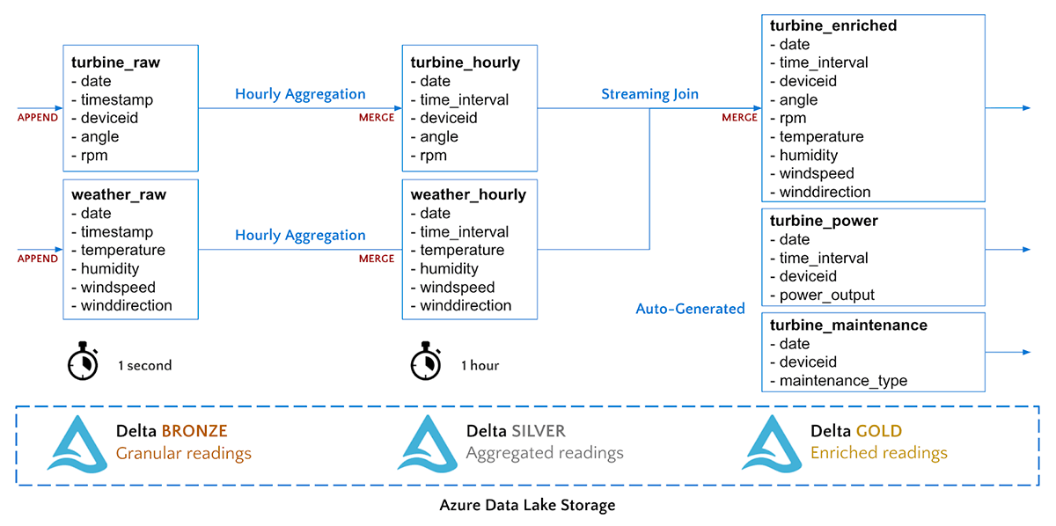
Topic 3 of 6
Implementation in Data Lake
Notes:
Source: https://databricks.com/blog/2020/08/11/modern-industrial-iot-analytics-on-azure-part-2.html

Slide 8
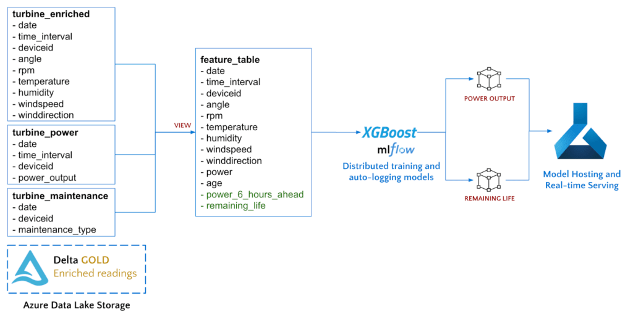
Topic 3 of 6
Implementation in Data Lake
Notes:
Source: https://databricks.com/blog/2020/08/11/modern-industrial-iot-analytics-on-azure-part-2.html

Slide 9
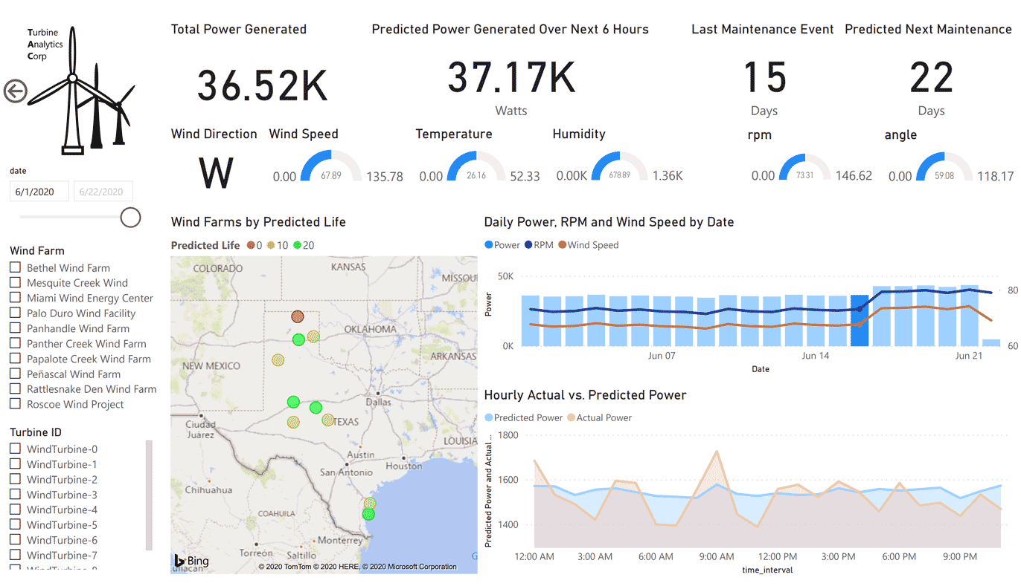
Topic 4 of 6
Predictive Maintenance Dashboard
Predictive Maintenance Dashboard
Notes:
Source: https://databricks.com/blog/2020/08/20/modern-industrial-iot-analytics-on-azure-part-3.html

Slide 10
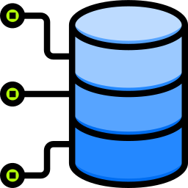

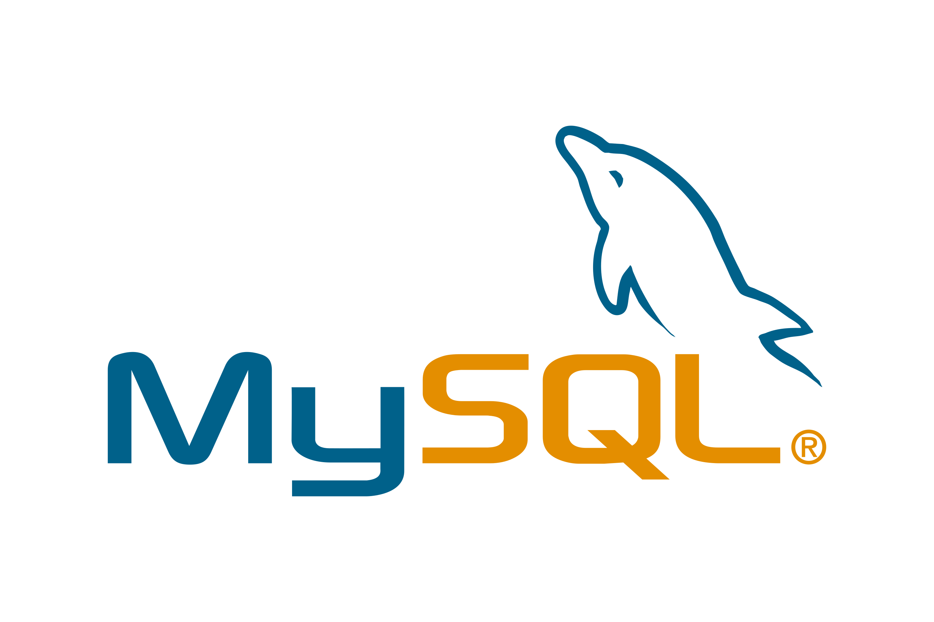

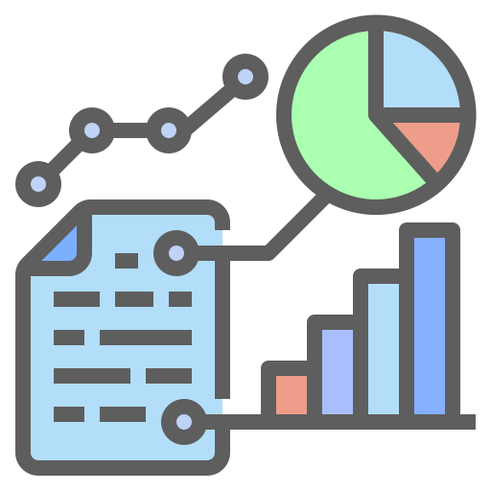













Topic 5 of 6
The Data Science Process Flow
1 Get Data from Data Silos
6 Impact Analysis
Bring data from data silos to data warehouses (ETL)
Data Science is experimental. Fail fast and build faster to maximize profit
2 Understand what the business does
5 Present to the
Business Stakeholders
The business already does things a certain way. First, match the business to show business impact
Analytics is only helpful to the business if it helps them make money. Data Science is Business, Mathematics & Technology.
3 Data Engineering
4 Machine Learning
Orchestrate and build pipelines to automate the process
Models are of three main types: Heuristics-based, Statistical or AI/ML

Slide 11


Topic 5 of 6
Key Takeaways
01
Predictive Maintenance in the Engineering Industry
03
Data Science Process Flow
02
Real-world Machine Learning (MLOps)

Slide 12

Anomaly Detection in Wind Turbine
using Data Science and Big Data
Anish Mahapatra
Q&A Session
LinkedIn: www.linkedin.com/in/anishmahapatra
Email: anishmahapatra01@gmail.com

Slide 13
Anomaly Detection in Wind Turbine
using Data Science and Big Data
Anish Mahapatra
Q. How to get into Data Science?
A. Simple, ask a real-world Data Scientist.
Email: anishmahapatra01@gmail.com
Thank you.

